Slide 1



Student Members
Vaishnavi Shinde (20104002)
Gandharvi Walavekar (20104045)
Dhananjay Phalke (20104120)
Aryan Sankholkar (20104010)

Slide 2
Contents
Introduction
Objectives
Scope
Features / Functionality
Project Outcomes
Technology Stack
Block Diagram

Slide 3

We all know “Physical fitness is the first requisite of happiness”. Our proposed “Fitness Regime Management System” is for those who run a fitness/gym business.
The Fitness Regime Management requires a system that will handle all the necessary & minute details easily & proper database security according to the user.
This project is designed to facilitate a fitness regime to automate operations of storing data about members, payroll and all the transactions that occur in a regime.

Slide 4

The objectives of this project are summarized below:
To design and develop a user friendly Fitness Regime Management System.
To keep a track on member’s progress.
To develop an easy to use software which handles the customer staff relationship in an effective manner.
To create an adaptable software which outlines the benefits of a healthy lifestyle.

Slide 5

As the technology and the passion for being fit and healthy has seen a significant growth since the pandemic.
Therefore, Fitness Management System has become the need of the society and the fitness industry.
BEFIT is here to instruct people about the importance of health and provide easiness in finding all the information at one place.

Slide 6

The feature and functionality implemented is as follow:
Feature 1 : Training and workout
Our fitness project includes workout plans and videos with explanatory comments and is easily able to adapt to the user.
Feature 2 : Diet and Nutrition
We provide suitable diet plan and tips on supplements and sports nutrition
Feature 3 : Personalized Trainer/ Nutritionist
For a better and more productive interaction with the client, we offer two well experienced trainer’s.

Slide 7

The final outcome of the project is as follows:
Admins are able to access all the data.
Members are able to
Acquire all the workout plans.
Obtain personalized diet plans.
Hire a personalized trainer.
Manager are able to keep a track on all the members.

Slide 8

Language used : Java
Database : MySQL, JDBC Connector
Framework: NetBeans IDE 12.5

Slide 9
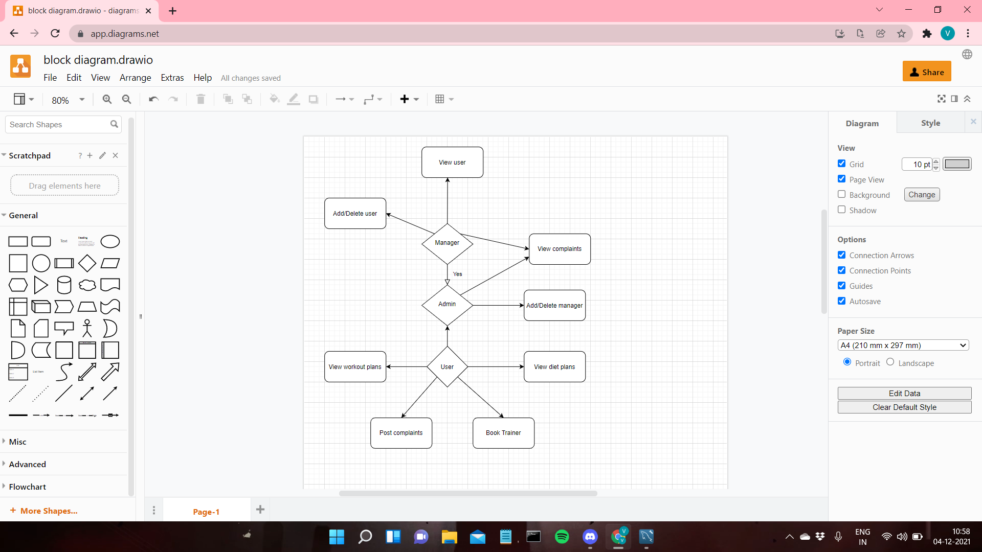
BLOCK DIAGRAM

Slide 10
Thank You...!!

